Slide 1
SIG-NOC Tools Survey Results
Maria Isabel Gandía Carriedo, CSUC
12 RIPE SEE Meeting
22-23 April 2024, Athens

Slide 2
Before we start...
This presentation shows the results of a survey about NOC tools per function.
I have no interest in promoting or going against any of the tools shown here.

Slide 3
Introduction - The GÉANT Project
GÉANT is the collaboration of European National Research and Education Networks (NRENs) on delivering an information ecosystem of infrastructure and services to advance research, education and innovation on a global scale:
50 million users
500 contributors from 37 R&E partners
9 projects so far
Current project generation: GN5-1
Project Management
Marcoms, Events and Policy Management
User and Stakeholder Engagement
Above-the-net services
Trust and Identity Services Evolution and Delivery
Network Development
Network Core Infrastructure and Core Service Evolution and Operations
Security
Operations support

Slide 4
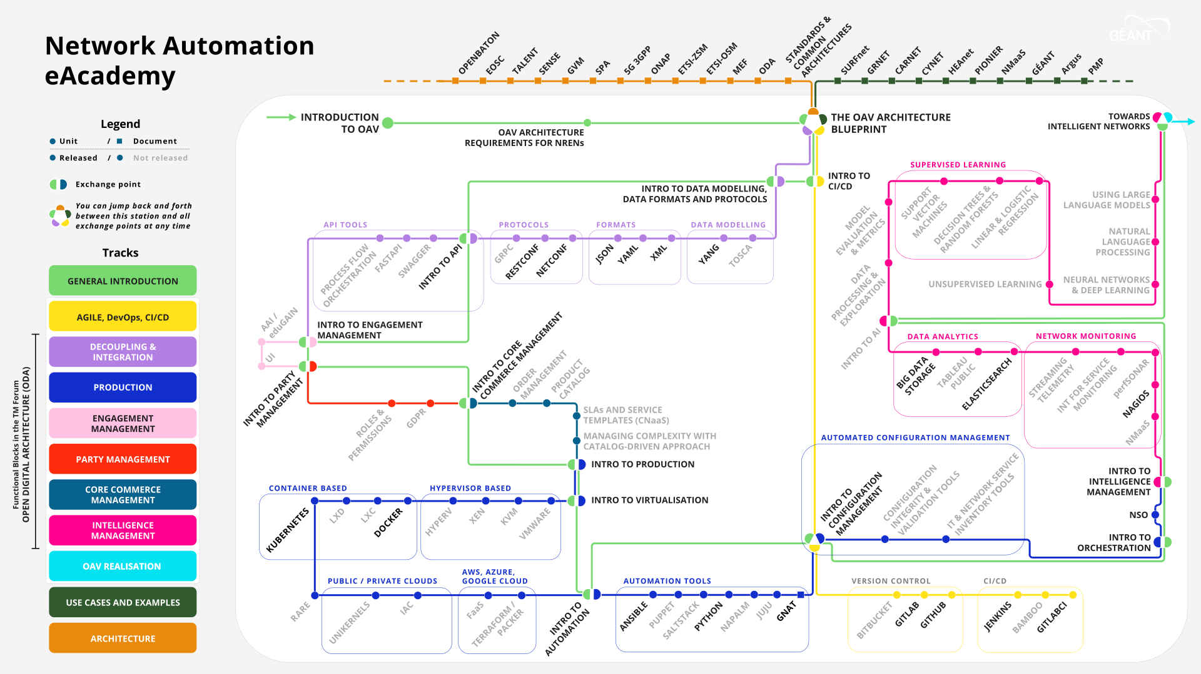
Introduction - The GÉANT Project
GÉANT is the collaboration of European National Research and Education Networks (NRENs) on delivering an information ecosystem of infrastructure and services to advance research, education and innovation on a global scale:
50 million users
500 contributors from 37 R&E partners
9 projects so far
Current project generation: GN5-1
Project Management
Marcoms, Events and Policy Management
User and Stakeholder Engagement
Above-the-net services
Trust and Identity Services Evolution and Delivery
Network Development
Network Core Infrastructure and Core Service Evolution and Operations
Security
Operations support

Slide 5
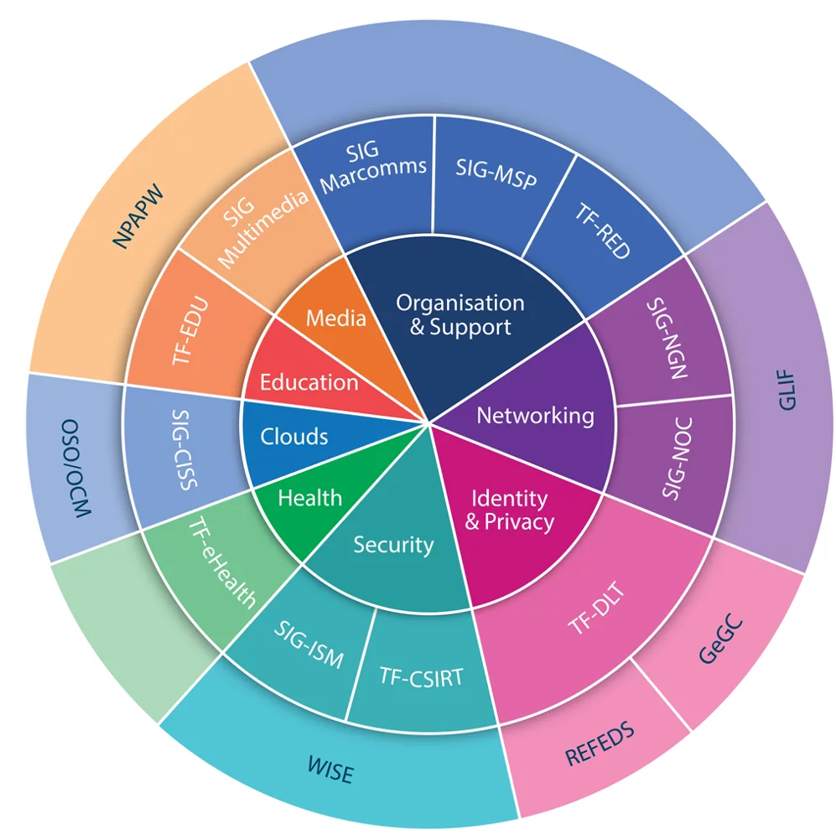
Introduction - GÉANT SIGs
GÉANT Special Interest Groups - SIGs are established under the auspices of GÉANT in order to create an
open forum
where experts from its community
exchange information, knowledge, ideas and best practices
about specific technical or other areas
of business relevant to the research and education networking community.

Slide 6
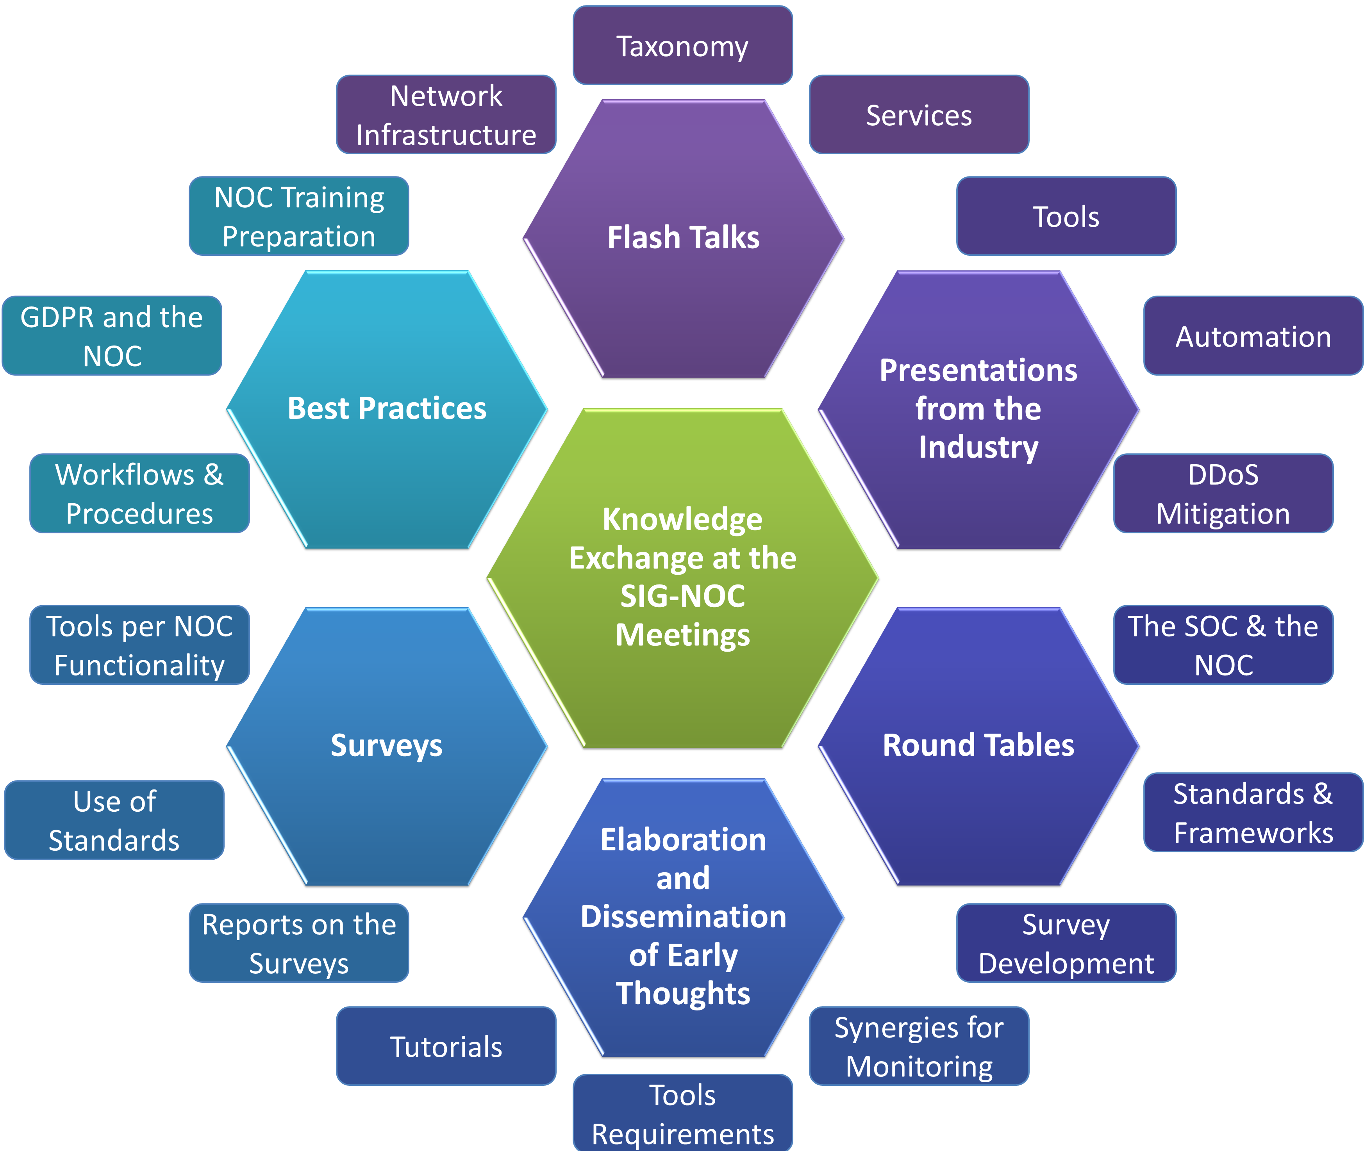
Introduction - The Special Interest Group for Network Operation Centres (SIG-NOC)
SIG-NOC is a forum to exchange and promote ideas, experience and knowledge on NOC tools, functions, workflows, procedures and best practices, making communication easier.
Quite like any NOG, but for R&E!
Sharing Knowledge to Manage R&E Networks

Slide 7
The 4th SIG-NOC Tools Survey - Previous Work
1st Survey: July-October’11, published January’12.
  NOCs’ taxonomy, structures, resources, tools, standards…
  14 functions
  53 questions, 43 valid responses
  Open boxes to add feedback
2nd Survey: December’15-February’16, published in June’16.
  Tools, standards
  15 functions (14 + DDoS Mitigation)
  35 questions (66), 64 valid responses
  Rating on importance (low/low-mid/mid-high/high) & quality (poor/fair/average/good/excellent)
3rd Survey: July-September’19, published in November’19.
  Tools, standards
  16 functions (15 + Orchestration, Automation and Virtualisation)
  35 questions (74), 63 valid responses
  Rating on importance (low/low-mid/mid-high/high) & quality (poor/fair/average/good/excellent)

Slide 8

The 4th SIG-NOC Tools Survey
May-October’23, published in November’23.
  Tools, standards
  17 functions (16 + Training)
  37 questions (82), 68 valid responses (82 responses, not all them valid*)
  Rating on importance (low/low-mid/mid-high/high) & quality (poor/fair/average/good/excellent)
*What is an invalid response?
  No answers given
  Only a "Yes" in one section (usually monitoring) with no rating for tools
  No valid name / dummy name
  Duplicated (only one institution that answered twice but informed about different departments being responsible for different functions was kept)

Slide 9
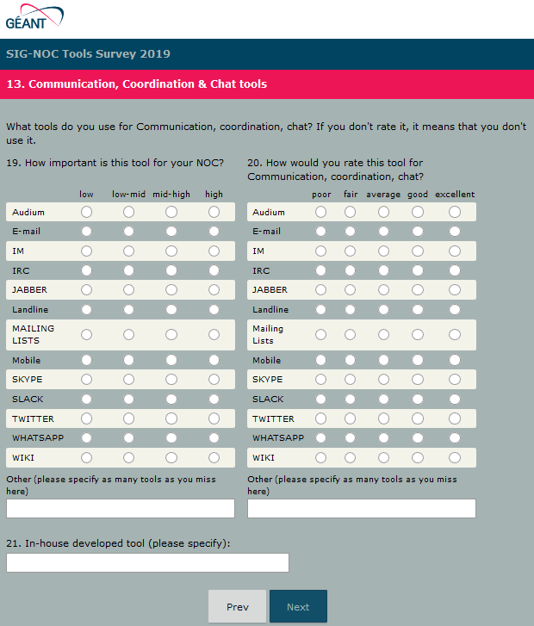

Structure of the Survey
For each one of the functions:
Short definition of <function>
Is your NOC responsible for <function>?
  Yes → You were asked the questions below
  No → Jump to the next function
What tools do you use for <function>?
  How important is this tool for your NOC?
  How would you rate this tool for <function>?
The pre-defined responses in the survey were all the tools that were rated or mentioned by two or more respondents in the 2019 survey
Open boxes allowed adding other tools, including in-house developed solutions, for each function.

Slide 10
Analysis of the Responses How-To
TOOL4
TOOL5
TOOL2
TOOL3

Slide 11
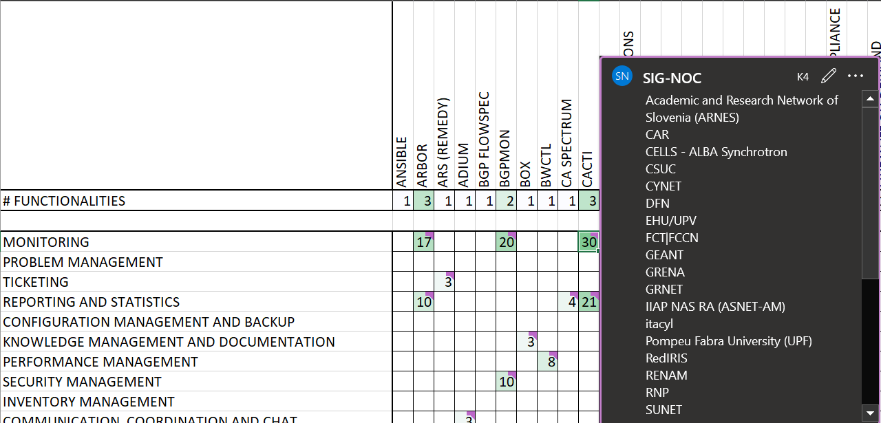
Analysis of the Matrix How-To
The Matrix contains the number and the institutions that use each tool for each function.
If you download the matrix and go to each cell with a number, you get the list of institutions that use it and that are ok with publishing the information.

Slide 12
Type (range) of the network that your organization is responsible for

Slide 13
NOC Functions

Slide 14
Average Number of Tools per Function

Slide 15
Monitoring Tools: Importance & Frequency for each Type of Methodology
3
Frequency: daily / few times a week / once a week / once a month / only in case of incident

Slide 16
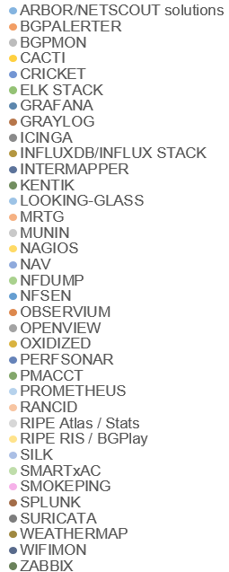
Monitoring Tools

Slide 17
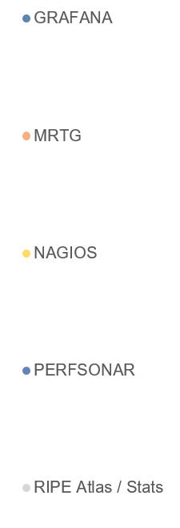
Monitoring Tools – Zoom in: Only the Top-5

Slide 18
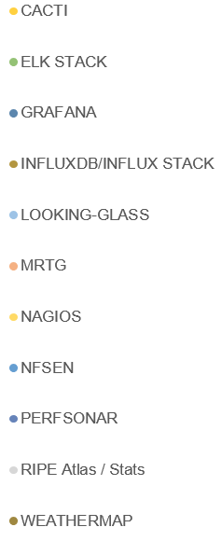
Monitoring Tools – Zoom in: Only the Top-10

Slide 19
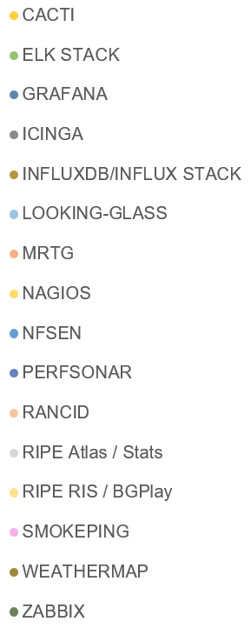
Monitoring Tools – Zoom in: Only the Top-16

Slide 20
Trends for Monitoring – Top 10
{
{
First appearance of Grafana, directly to the first position.
Nagios and Cacti are still popular, with MRTG going up.
perfSONAR takes off and reaches the Top-10 for the first time.
Smokeping and NFDUMP disappear from the Top-10 (but they are close)
On average, each institution uses 11.5 different tools for monitoring

Slide 21
Problem Management Tools

Slide 22
Trends for Problem Management – Top 10
{
{
{
Mix of open-source / vendor-based and distributed tools.
Increasing usage of RIPE Atlas / Stats.
Jira goes down from the 1st to the 3rd / 4th position.
Less usage of the ELK stack (but still 31% of the respondents use it)
On average, each institution uses 4.7 different tools for problem management

Slide 23
Ticketing Tools

Slide 24
Trends for Ticketing Tools – Top 5
Request tracker goes back to the first position after being replaced by Jira in 2019.
Not even the most popular tool reaches 50% of the respondents for this question.
ARS Remedy disappears, but 1 respondent mentions RemedyForce (the cloud version)
Other tools mentioned once: ProactivaNet and Youtrack.
On average, each institution uses 1.5 tools for Ticketing

Slide 25
Knowledge Management and Documentation Tools

Slide 26
Trends for Knowledge Management and Documentation – Top 10
Confluence remains on the first position
New tools appear in the upper part of the Top-10: Gitlab, Netbox, Nextcloud.
Several tools going down: Google Drive, Wiki and Owncloud go 4 positions down.
OTRS, Sharepoint, Mediawiki, Request Tracker and Dropbox disappear from Top-10.
On average, each institution uses 5.2 tools for Knowledge Management

Slide 27
Reporting and Statistics Tools

Slide 28
Trends for Reporting and Statistics – Top 10
Grafana is again the most popular tool, shortly followed by Request Tracker.
Increasing usage of Splunk and Munin.
On average, each institution uses 4.4 tools for Reporting and Statistics

Slide 29
Communication, Coordination and Chat Tools – Bi-directional

Slide 30
Trends for Communication, Coordination and Chat Tools – Bi-directional – Top 10
We still use traditional e-mail-based tools for communication (E-mail and mailing lists).
More relevance of asynchronous chat tools.
Telephone calls are less relevant. Landline is even out of the Top-10.
Edumeet is on the 12th position.
On average, each institution uses around 6.4 tools for Bidirectional Communication, coordination & Chat

Slide 31
Communication, Coordination and Chat Tools – Uni-directional

Slide 32
Trends for Communication, Coordination and Chat Tools – Uni-directional – Top 5
We still use traditional e-mail-based tools for communication (E-mail and mailing lists).
IRC has zero users
Some organisations use Twitter for unidirectional communication
On average, each institution uses around 2.8 tools for Unidirectional Communication, coordination & Chat

Slide 33
Configuration Management and Backup Tools

Slide 34
Trends for Configuration Management and Backup Tools– Top 6
{
Git & Rancid are the most popular tools. The rest are used by less than 50% of respondents
Subversion goes down in the ranking.
On average, each institution uses 2.3 tools for Configuration Management and Backup

Slide 35
Other Functions & Facts
Other Functions & Facts
Inventory Management
Configuration Management
Performance Management
Out-of-band
Access Management
Other facts:
  Although Netbox or Confluence are the best rated, Excel remains the most popular tool for Inventory Management and Resources Management.
  As more institutions have SOCs, the percentage of NOCs who feel responsible for Security Management decreased (from 63% to 45%).
  Automation is still the function less NOCs feel responsible for.
You can see the results for other functions here: https://wiki.geant.org/display/SIGNOC/SIG-NOC+Tools+Survey+2023
Resources Management
Data Aggregation, Representation, Visualization
DDoS Mitigation
Training
Orchestration, Automation and Virtualisation
Security management

Slide 36
Conclusions
The ecosystem is huge and biodiverse, NOCs work with dozens of tools.
There is no tool that has all we need, even for the same function.
There is no tool that works for all the functions, or even for a high percentage of them.
Having a mix of open-source / vendor-based and distributed tools is the common rule.
If you are starting a NOC, the survey can give you some ideas. Taking the 5 or 10 most popular and best rated tools should probably help making decisions.
The survey helps you understand which tools are more popular for the community and for which functions, and also past trends.
But if you have a wonderful tool that works for you, no need to change it!

Slide 37
Thank you!
netdev@lists.geant.org

